Slide 1

Belton Independent School
District

Slide 2


Slide 3

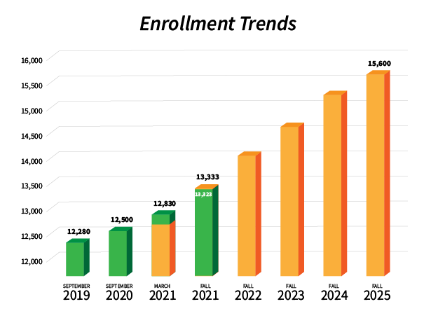
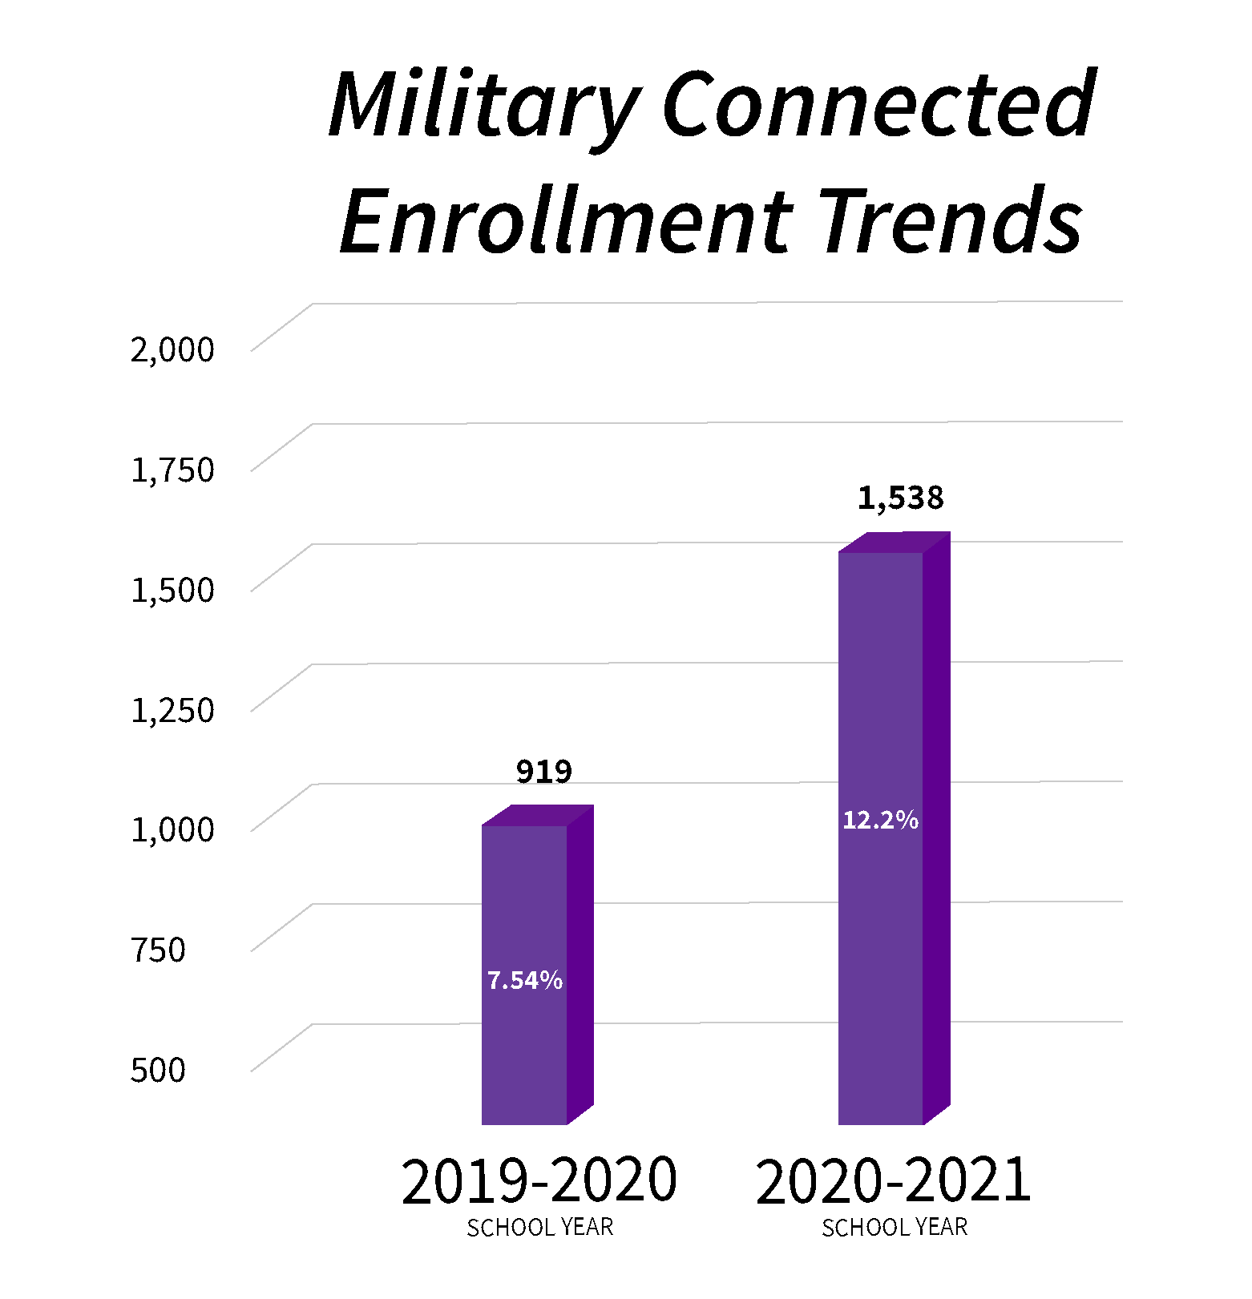


ENROLLMENT GROWTH
ACTUAL
FORECAST

Slide 4
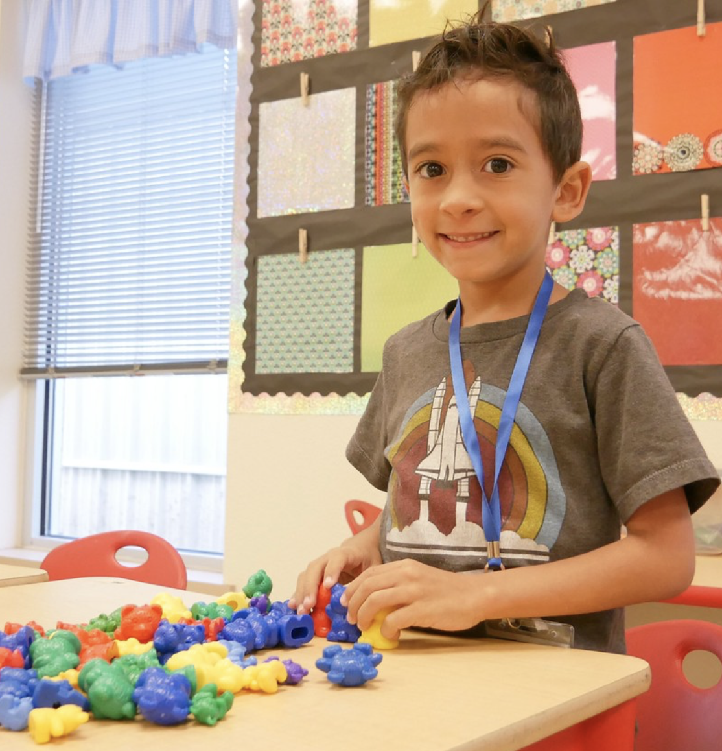
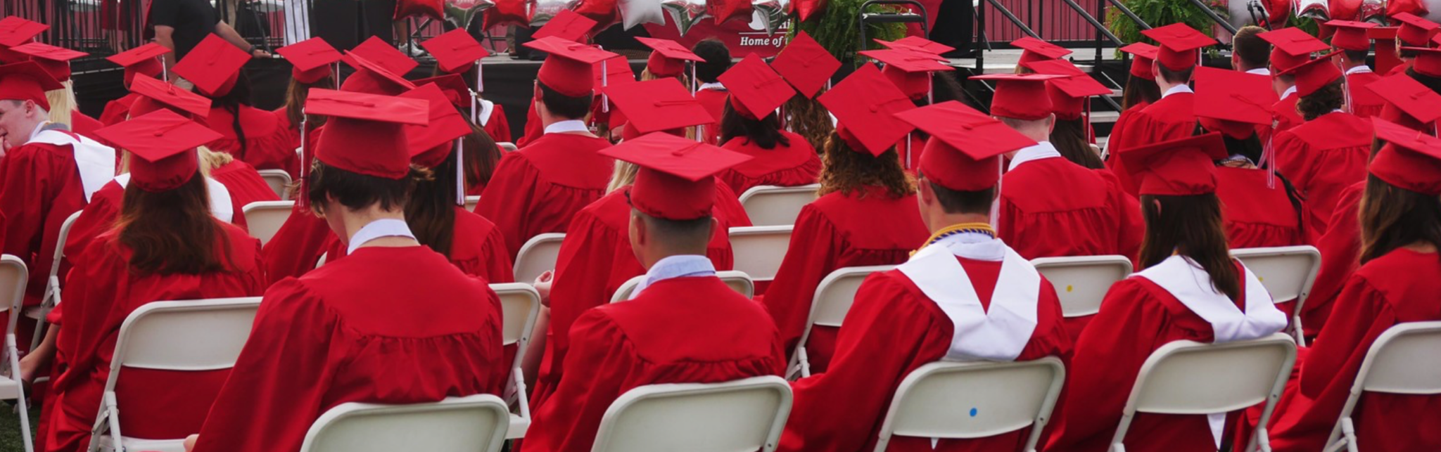
Exceptional learning experiences for each and every student, each and every day.

Slide 5


Slide 6
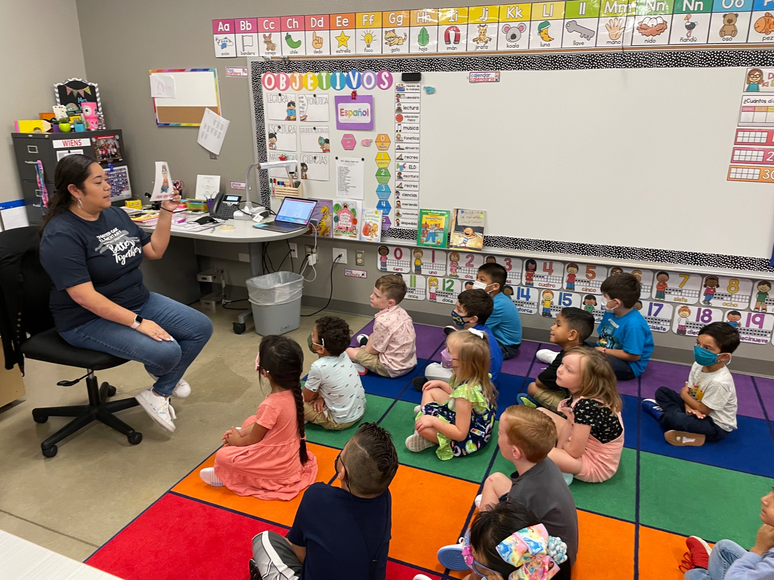
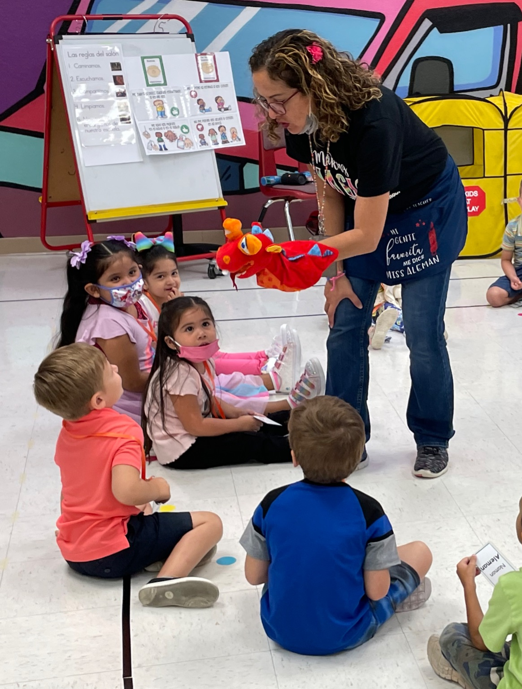
DUAL LANGUAGE

Slide 7

Copperas Cove Independent School
District
District Presentation
https://s3.amazonaws.com/scschoolfiles/1223/forthoodccisd.mp4

Slide 8

Florence Independent School
District

Slide 9
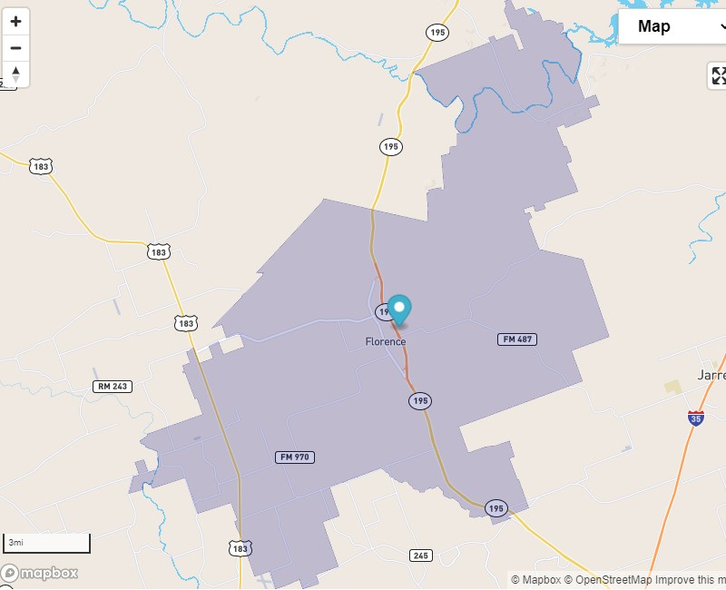
District Map

Slide 10
Demographics
Enrollment
School Year | Enrollment
2016-2017 | 1025
2017-2018 | 1048
2018-2019 | 1086
2019-2020 | 1102
2020-2021 | 1075

Slide 11
Demographics
Socioeconomic
School Year | Econ. Dis. | Percent
2016-2017 | 666 | 64.98
2017-2018 | 553 | 52.77
2018-2019 | 653 | 60.13
2019-2020 | 667 | 60.53
2020-2021 | 638 | 59.35

Slide 12
Demographics
Military Connected
School Year | Military | Percent
2016-2017 | 34 | 3.52
2017-2018 | 30 | 2.86
2018-2019 | 14 | 1.29
2019-2020 | 99 | 8.98
2020-2021 | 113 | 10.51

Slide 13
Projected Enrollment
Projected 2021 Snapshot Enrollment = 1,146
Five Year Enrollment = 1,496 growth of 451 students
Ten Year Enrollment = 2,305 growth of 1,230 students

Slide 14
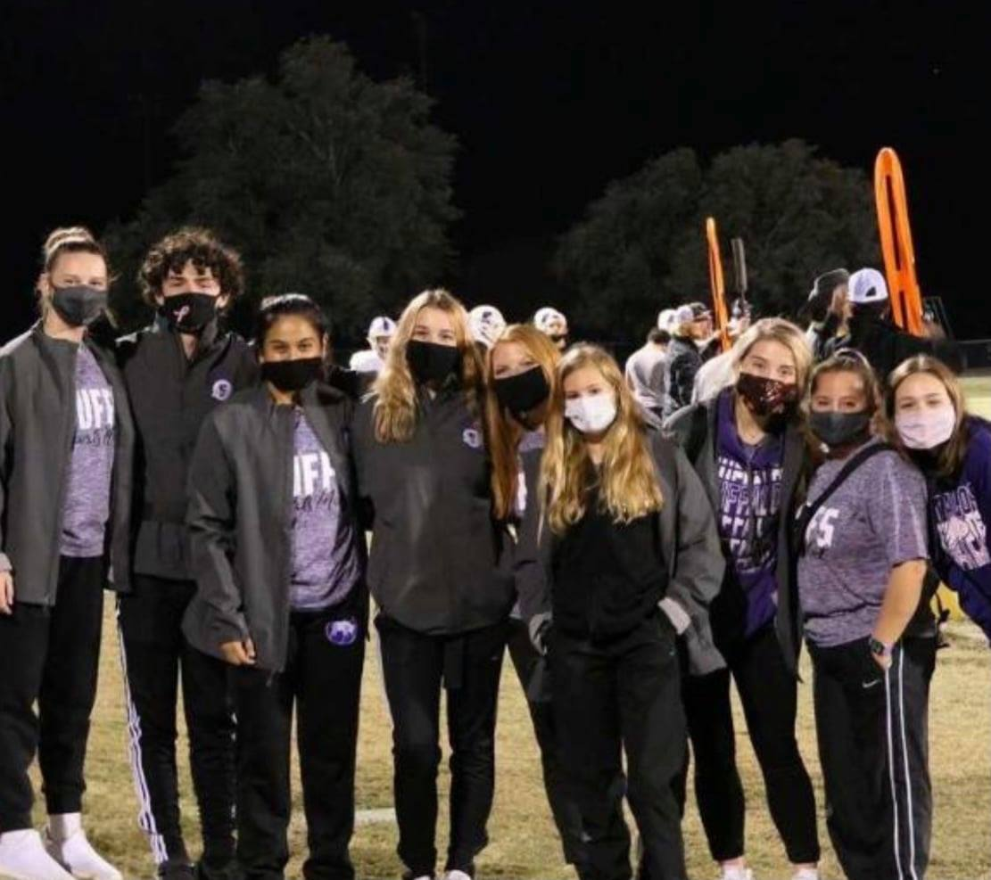
Covid Impact
2020-2021
In-Person Instruction 84%
Remote Instruction 16%
Masks Mandatory
2021-2022
In-Person Instruction 100%
Masks Optional

Slide 15
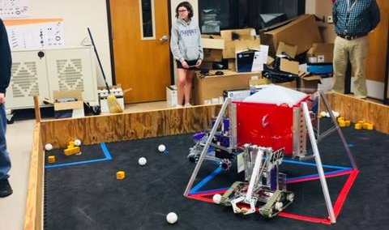
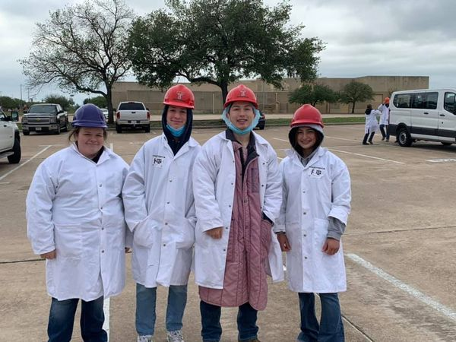
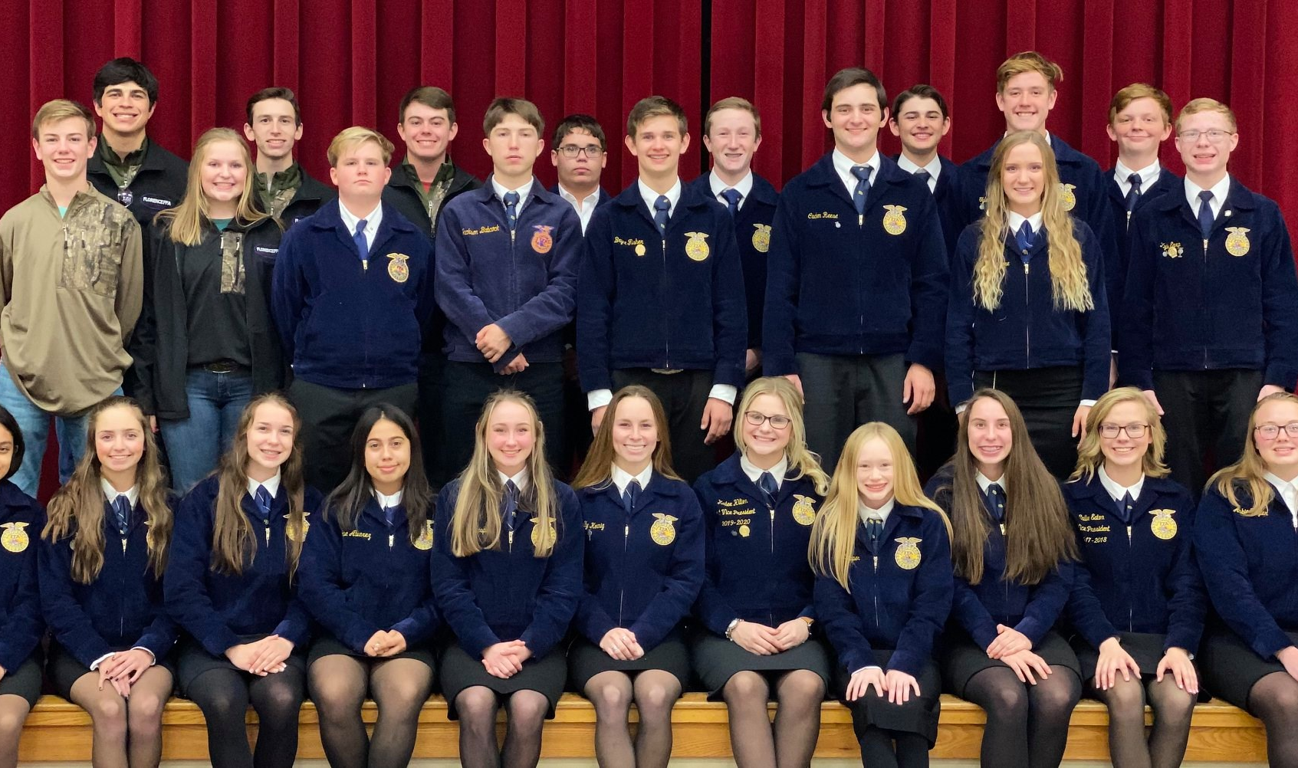
Programs/Initiatives
Meat Lab
Robotics
FFA

Slide 16



Programs/Initiatives

Slide 17

Jarrell Independent School
District
District Presentation
https://youtu.be/Vbi77r2QkNU

Slide 18

Killeen Independent School
District

Slide 19
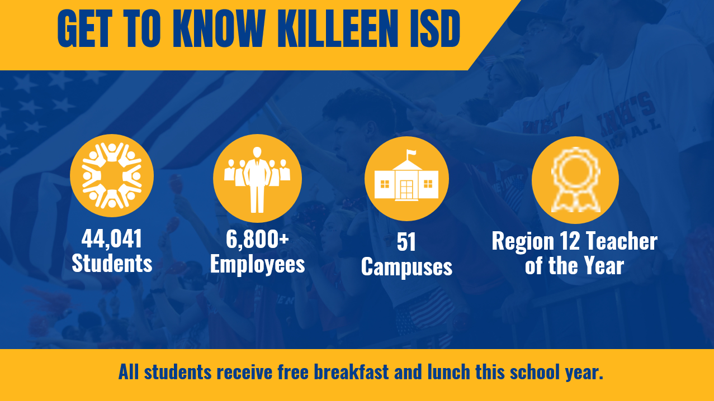

Slide 20
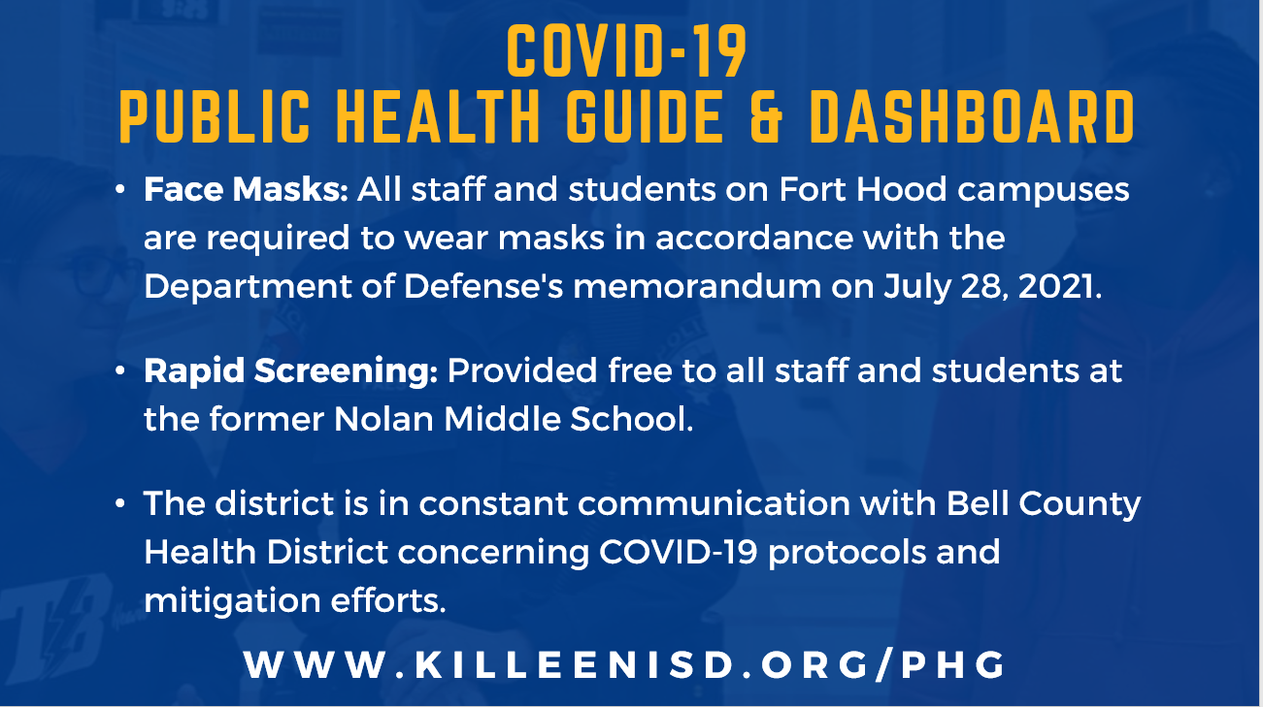

Slide 21
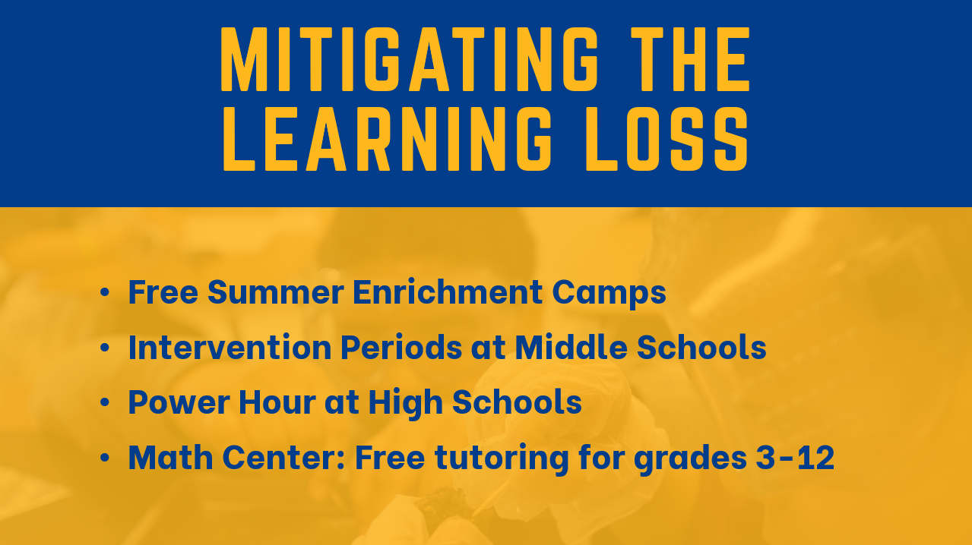

Slide 22


Slide 23
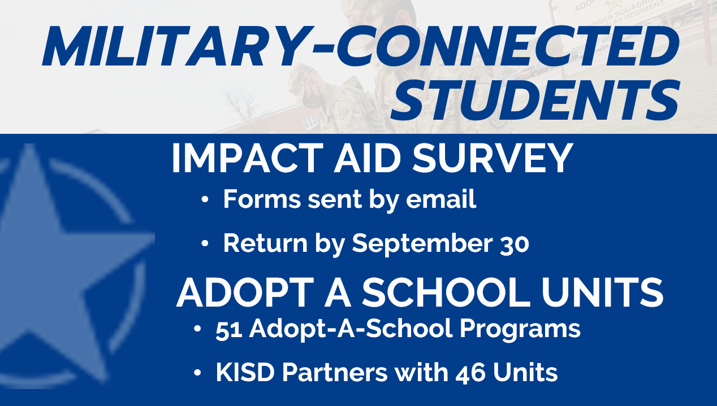

Slide 24
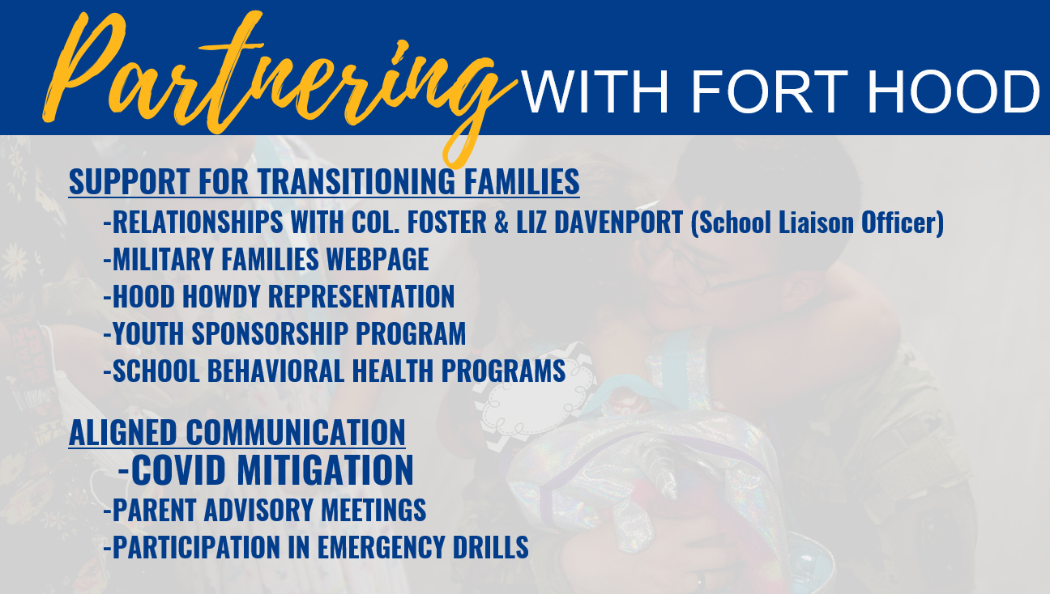

Slide 25


Slide 26
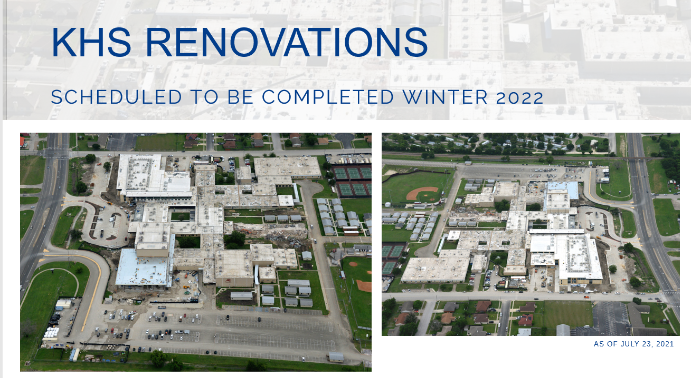

Slide 27
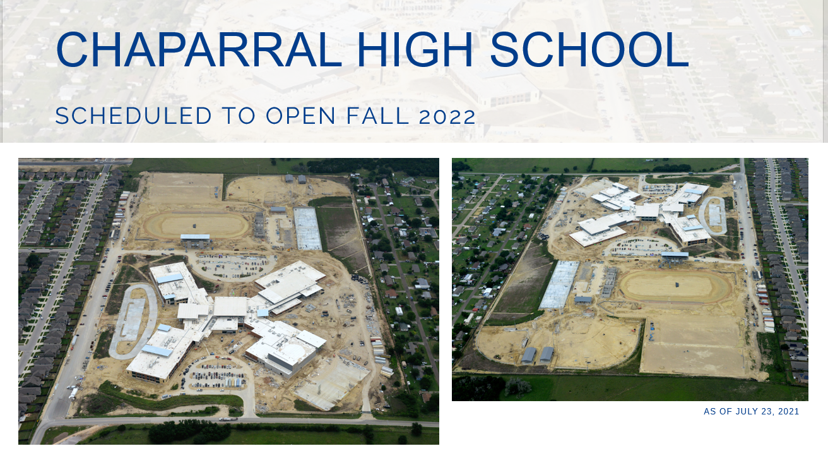

Slide 28
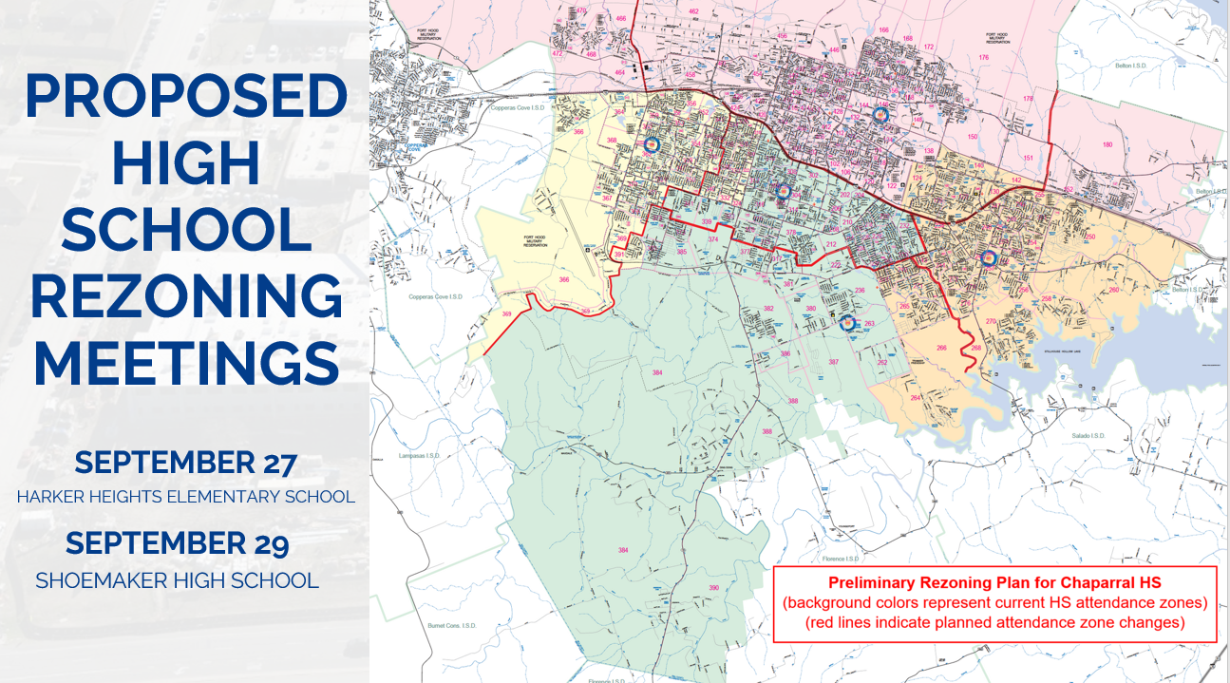

Slide 29
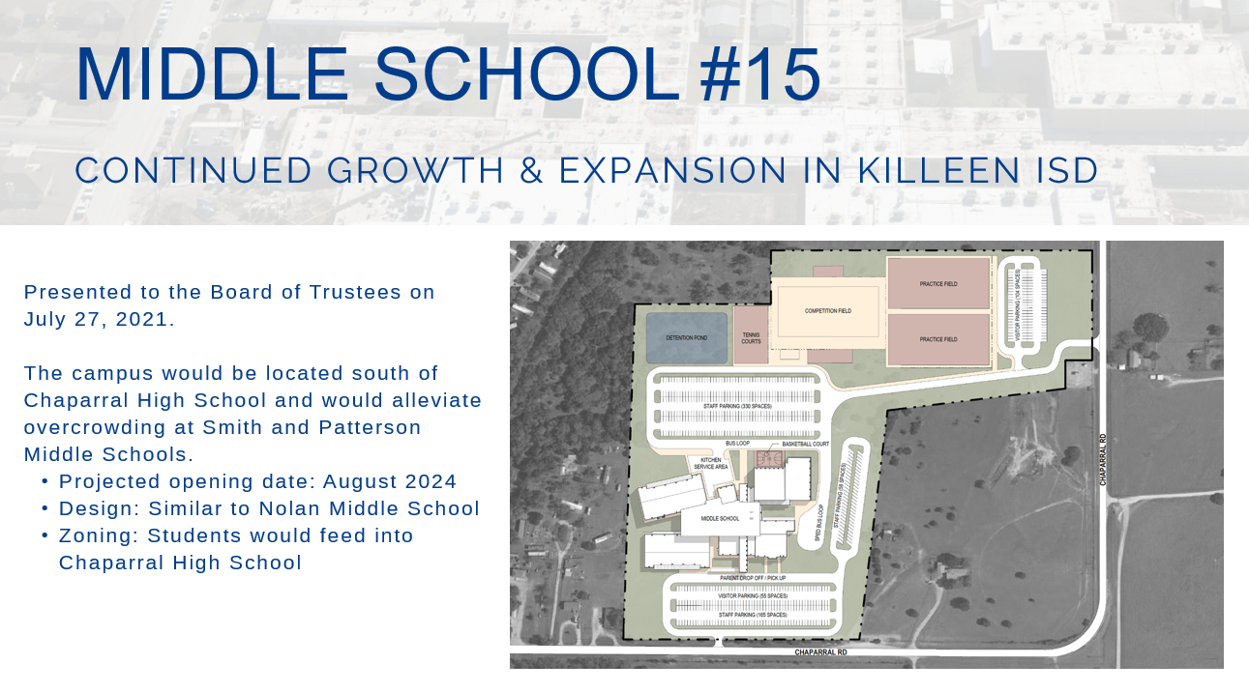

Slide 30


Slide 31


Slide 32


Slide 33


Slide 34

Lampasas Independent School
District

Slide 35

Lampasas ISD
Enrollment: 3417
Staff: 515
Teachers: 230
Started: August 12
Campuses: 6
Mascot: Badgers

Slide 36
Lampasas ISD
Update:
New Culinary Art Building Completed
New Automotive/Veterinary Building Started
Community Reading Program.

Slide 37

Lampasas ISD
Free book to all kids aged 5 and below.
Book delivered once a month to the child’s home with their name on it
Register online and at the local library.

Slide 38

Salado Independent School
District

Slide 39
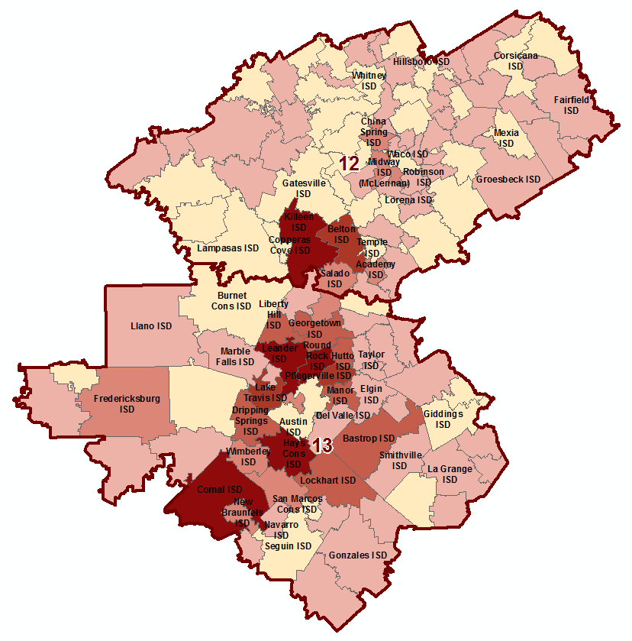
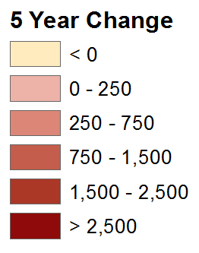
Region 12 & 13 Enrollment Growth
Salado ISD has added 506 students in the last 5 years
This is a 5 year growth rate of 38%
Salado ISD is the fastest growing district in Region 12, based upon percentage increase

Slide 40
Salado ISD Enrollment
  1990 – 1991 = 559 students
  2012 – 2013 = 1,348 students
  2013 – 2014 = 1,461 students
  2014 – 2015 = 1,556 students
  2015 – 2016 = 1,656 students
  2016 – 2017 = 1,748 students
  2017 – 2018 = 1,854 students
  2018 – 2019 = 1,956 students
  2019 – 2020 = 2,054 students
  2020 – 2021 = 2,075 students
  This is the highest enrollment percentage increase of all 76 school districts in our region

Slide 41
Schools
Thomas Arnold Elementary School
  Pre-kindergarten-3 through 5th grade
  Renovations completed in 2019
Salado Middle School
  6th grade through 8th grade
  Built and opened in 2020
Salado High School
  9th grade through 12th grade
  New baseball field, softball field, tennis courts built in 2020
  Renovations to the football/soccer/track stadium in 2019

Slide 42
Opportunities to Earn College Credit
Advanced Placement
Dual Credit through Temple College
On Ramps through the University of Texas-Austin
Texas Bioscience Institute at Temple College

Slide 43

WE ARE LOOKING FORWARD TO A GREAT SCHOOL YEAR!
Please call me, text me, e-mail me or stop by to see me anytime I can help:
Michael Novotny
michael.novotny@saladoisd.org
(254) 947-6905 (office)

Slide 44

Temple Independent School
District
District Presentation
https://www.wevideo.com/view/2370021256

