Slide 1
SCHOOLS COUNCIL MEETING
16 SEPTEMBER 2021
Sheila R. Curtis
Chief
Child & Youth Services

Slide 2
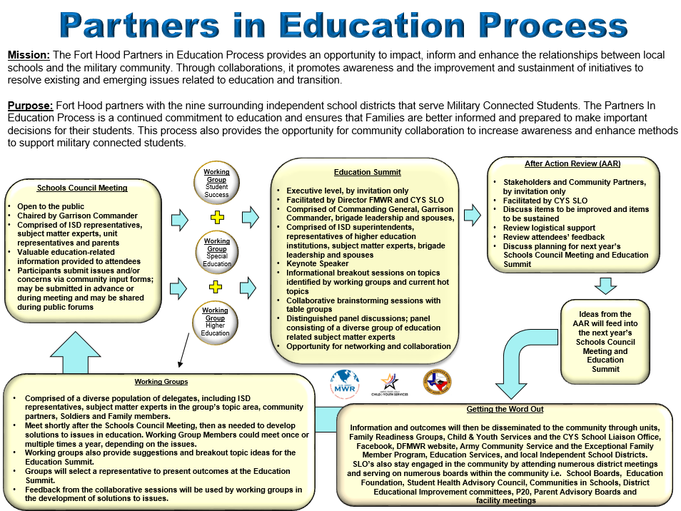

Slide 3
Purpose and Goals
Continue development of processes and tools to assist parents and school districts with transition issues
Collaborative forum to address issues, concerns and positive experiences
Community Input Form
Parents and participants to have direct involvement in their child’s education
Connections with area School Districts and Central Texas communities
Working Groups discuss, collaborate, propose recommendations
Education Summit 04 February 2022

Slide 4
Youth Sponsorship Program
“The Secretary of Defense shall require that there be at each military installation a youth sponsorship program to facilitate the integration of dependent children of members of the armed forces into new surroundings when moving to that military installation as a result of a parent’s permanent change of station.”
Notes:
STATE
This program is codified by Public law and interpreted by Department of Defense Instruction 6060.4 and Army Regulation 215-1. Under 10 U.S.C. §1785 The Youth Sponsorship program was revamped in June of 2019. This program was put in place at Military Installations around the world to make sure there was continuity for military students when moving installation to installation.

Slide 5
Youth Sponsorship Provides…
Information
Orientations
Web-Based Information
Welcome Packets
Belonging
Youth Led
Welcome and Farewell Activities
Recognition
Friendship
Connect Youth to Their Interests
Peer-to-Peer Communication
Notes:
STATE
Sponsorship is about helping youth make smooth transitions in their community. The focus of the program is to provide youth in transition with Information, a Sense of Belonging, and an Opportunity to Make Friends.
For children who do not move, but live in a military community this program can provide them with a sense of purpose and meaning as they help others with the transition.
The skills a sponsor learns can help them to work through the loss of their military friends as well as help them learn to cope with various life transitions they might have. The program outcomes of information, belonging and friendship are fulfilled by providing orientations/tours, web-based information and welcome packets ; youth led activities and programming to include welcome and farewell events, recognition; improved peer to peer communication skills and relevant interest based connections for youth.
A strong YSP helps youth adjust to their installations, communities, and schools while building resilience. The key to this success is committed staff and youth dedicated to delivering a quality program.

Slide 6
Benefits to Youth
Positive Identity
Satisfaction in helping others
Sense of Purpose
College and Career Readiness
Coping and Resilience Skills
Advisors as References
Empowerment
Increased knowledge of community
Increased understanding of military transition
Service Learning
Leadership
Affect change
Notes:
STATE
Young people need to develop strong guiding values or principles to help them make healthy life choices.
Focusing on the benefits to the youth and considering the 40 assists as defined by the Search Institute, we see the Youth Sponsorship program providing student sponsors with positive identity through a sense of purpose; given opportunities for leadership though program activities and being fulfilled in their role though helping others.
They in turn, learn and practice coping and resiliency skills though programing, can utilize their advisors as references and build volunteer hours, all positively strengthening their college and career readiness. This leads to an overall feeling of empowerment as they affect change, have an increased knowledge of their community and a greater understanding of military transitions.
Empowerment results due to an increased knowledge of the community by both the sponsor and sponsee, developing an increased understanding of the military transition leading to affecting positive change in the transitioning experience of the incoming youth.

Slide 7
Benefits to the Community
Boundaries and Expectations
Youth learn the rules and expectations early
Access Adult Role Models
Support
Improves how schools and centers welcome youth
Connection
Supports positive communication
Youth as Positive Peer Influence
Creates a team environment between the school, the installation, and the Family
Creates a caring environment for youth as they move into a new community
Connects youth to their community
Notes:
STATE
As benefits to the community, the program provides boundaries and clear expectations for youth. As Youth learn the norms and boundaries early on, the community will spend less time on behavioral concerns and more time and resources on strength based programming.
Coaching and mentoring support for youth exists due to immediate access to adult role models. Youth Sponsors act as positive peer influences allowing new youth to feel welcomed while gaining stability in their new environment.
Schools provides immediate support and while improving the process of receiving new students. This in turn creates a caring environment for the youth as a new member of the community.
New transiting youth experience positive communication and important information allowing them to immediately feel connected to their school, installation and community while creating a supportive team environment.

Slide 8
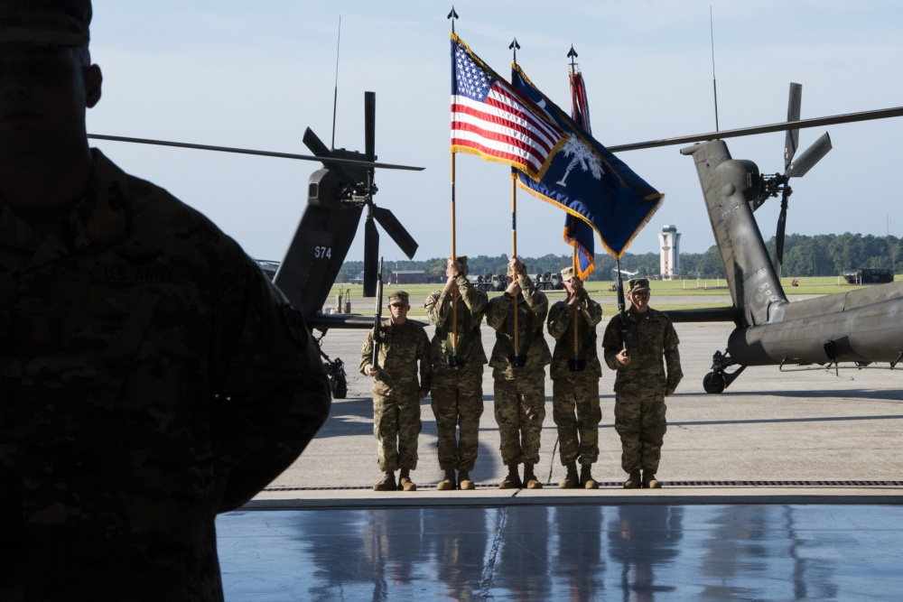
Increased Readiness
Reduced Youth Risk Behavior
Reduced Stress in Youth and Parents
Increased School Achievement
Build Resilience
Notes:
STATE
The Army’s definition of Resiliency is the ability to grow and thrive in the face of challenges and bounce back from adversities. The Army’s 6 core resiliency competencies include Self Awareness, Self-Regulation, Mental Agility, Optimism, Strengths of Character and Connection.
The Youth Sponsorship Program helps youth develop these competencies. As the students build on their resilience and encompass the YSP focus of Information, a Sense of Belonging, and an Opportunity to Make Friends, research supports that youth who are connected to their communities exhibit:
Reduced Risk Behavior
Reduced Stress in Youth and Parents
Increased School Achievement;
Hence, these 4 outcomes (reference the slides by pointing) lead to the ultimate outcome,: “an increase in Soldier and Family Readiness” as the program assists in creating a work/life balance for the soldier.
This is accomplished as youth are provided the support and information they need during transition allowing the Soldier/Parent to focus on other transitional and work related needs while helping their youth connect to their school and community. Students have an expedited acclimation to the community that can also lead to increase usage of installation and community programs
REFERENCE
Mancini, J., Bowen, G., O’Neal, C., Arnold, A. (2015). Relationship provisions, self-efficacy and youth well-being in military families. Journal of Applied Developmental Psychology v40 17-15. Doi10.1016/j.appdev.2015.02003.

Slide 9
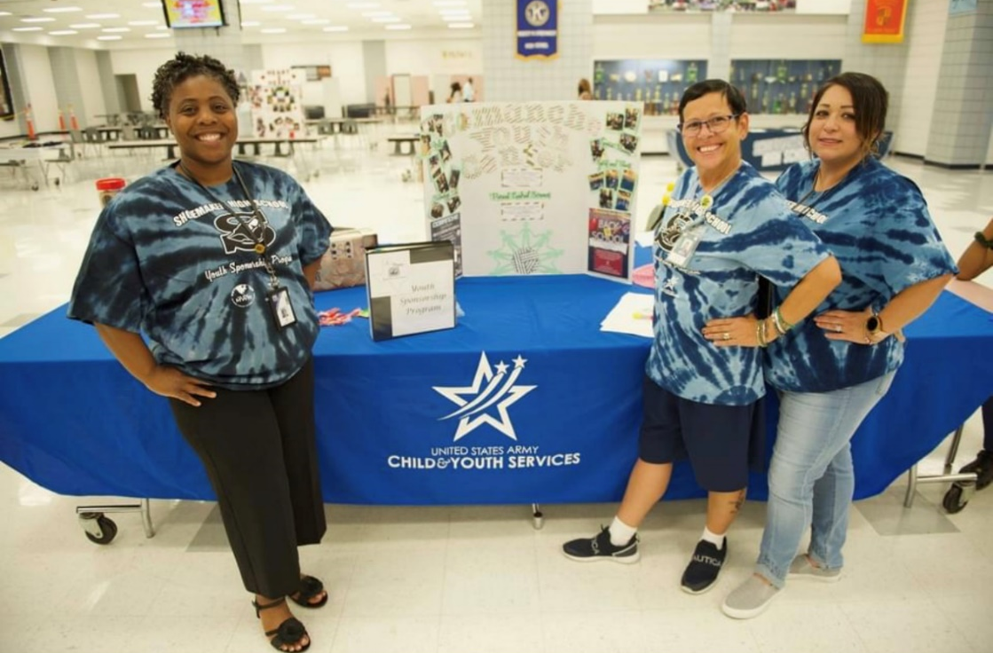
Current Numbers
Staff Trained
109
Youth Trained
166
Notes:
Numbers as of August 2021 helped 176 students transition to and from Fort Hood. 117 in and 59 out

Slide 10
?Questions?
Contact the CYS School Liaison Office for more information.
254-288-7946
Notes:
Do you have any questions at this time?

Slide 11

Vocational Rehabilitation (VR)
Transition Services

Slide 12


Workforce Innovation and opportunity act (WIOA)
Many students with disabilities are leaving secondary school without competitive integrated employment or being enrolled in postsecondary education, and there is a need to support such students as they transition from school to post-secondary life.
Title IV of WIOA changes the way transition services are provided through Vocational Rehabilitation and emphasizes transition and youth services throughout.
VR programs are required to spend 15% of their federal funding allocation on Pre-Employment Transition Services (Pre-ETS) to eligible and potentially eligible students with disabilities.
Pre-ETS are intended to provide exposure to the concepts and experiences related to building skills for work and independent living and are, therefore, more effective when started early.

Slide 13

Transition services
Transition services are a subset of Vocational Rehabilitation services for students with a disability between the ages of 14 and 22.
Transition services are provided to help students move from high school to successful work and independent living.
Through partnerships with the schools, Vocational Rehabilitation provides transition services to students while they are attending high school so they will be prepared when they graduate.
After your student leaves high school, Vocational Rehabilitation services continue to be available to them, if necessary.

Slide 14
Services provided in Transition
Career Exploration Counseling
Job Readiness Training
Work-Based Learning Experiences
Self-Advocacy
Counseling on Post-Secondary Opportunities

Slide 15
Career Exploration Counseling making informed choices about various job opportunities
O*Net Online Interest Profiler has 60 questions about work activities to help you decide what kinds of careers you might want to explore by matching careers to your interests.
  Realistic
  Investigative
  Artistic
Career One Stop:
  Career One Stop Interests Assessment – 30 quick questions that matches your interests to careers.
  Career One Stop “Skills Matcher” – This quiz asks what you like to do and what you are good at and matches you with careers.
  Career One Stop “Work Values Matcher” – This quiz determines your beliefs about what is important to you.
  Social
  Enterprising
  Conventional
Notes:
Realistic — practical, hands-on problems and solutions Investigative — ideas, thinking, and figuring things out Artistic — creating, designing, and making your own rules Social — helping people, teaching, and talking Enterprising — leading, making decisions, and business Conventional — data, detail, and regular routines

Slide 16
Job Readiness training develop social skills
A distinction between “hard skills” and “soft skills”
  Hard skill – measurable, technical proficiency
  Soft skill – ability to work well with others
Top 5 Soft Skills
  Communication
  Teamwork
  Adaptability
Vocational Adjustment Training includes structured classes that teaches daily workplace routine and addresses individual vocational impediments. VAT helps develop competencies and essential skills necessary to function successfully on the job.
There are 9 different curriculums offered in VAT covering topics such as soft skill development, job search, money management, and disability disclosure.
  Problem-Solving
  Critical Thinking

Slide 17

Work-based Learning experience in-school, after school paid, unpaid, internships
“Builds the Resume” by providing students with disabilities critical hands-on, real world experience and transferable skill development.
Work Experience Trainers are available to assist students with disabilities adjust to the workplace.
The Summer Earn and learn program
SEAL is a paid work-based learning experience.
  Students earn $9/hour paid by the Workforce Board, not the employer.
Program is seven weeks long
Students are matched with an employer based on their interests where possible
Students do not need to be VR customers

Slide 18

SSA Student Earned Income Exclusion
The SEIE is a way for students who receive SSI to retain more of their cash benefit when working.​
To qualify a student must meet all the following requirements:​
  Be under 22 years of age, ​
  Regularly attending school, ​
  Working, and​
  Receiving or be eligible for an SSI cash benefit
For 2021, the student earned income exclusion amount is $1,930/month not to exceed $7,770 for the year.
Summer Earn And Learn Program
  $9/hour x 40 hours/week x 4 weeks = $1,440

Slide 19

Instruction in Self-Advocacy
Self-advocacy is the ability to effectively communicate, convey, negotiate, or assert your own interests and/or desires
Learn how to describe your disability, disability needs, skills, and abilities.
Learn about the laws as you leave high school and enter the adult world.
  Individuals with Disabilities Education Act v.
  Americans with Disabilities Act
Learn about accommodations and identify accommodations that you might need.
Identify how and when you need to disclose personal information to receive accommodations.
https://askjan.org/

Slide 20
post-secondary opportunities
Post-Secondary Education
Certificate Program (<60 credits).
2-year Associates Degree (60 credits).
4-year Bachelors Degree (~120 credits).
Graduate-level Degrees to maintain and/or advance in current employment.
Entering the Workforce
Utilize certificate earned through endorsement.
Enter an internship or apprenticeship.
Other entryway into Competitive Integrated Employment.

Slide 21



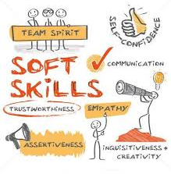

Potentially eligible
Based on federal law passed in 2014, some individuals can receive certain services without applying to the VR program. They must be a student between the ages of 14 to 22 and have a disability. The services provided are limited but are meant to assist the student in their transition to life after high school.

Slide 22

Potentially eligible students
Entering VR Services
If your potentially eligible student feels they will need additional VR services due to their disability(s) even after leaving high school, then they can apply to the VR program.
Your student will need to complete an application and be determined by a VR counselor to have met all the eligibility criteria.

Slide 23




How to get started
Contact your nearest Texas Workforce Solutions-Vocational Rehabilitation office.
Call: 512-936-6400
Email: vr.office.locator@twc.state.tx.us
Web Site: www.twc.texas.gov/VRNearMe

Slide 24

VR Office locator website
https://webp.twc.state.tx.us/services/VRLookup/
Enter Zip Code and County Only
Specialized Services will be listed on the results page:
  VR Services for Students
  VR Services for Individuals who are Blind and Visually Impaired
You may not see the Specialized Services listed in the results; do not worry. Call the office and you will be connected to the correct counselor.

Slide 25
Texas Workforce Commission
Contact information
Texas Workforce Solutions-Vocational Rehabilitation Services
101 East 15th Street
Austin, Texas 78778-0001
800-628-5115
Equal Opportunity Employer/Program
Auxiliary aids and services are available upon request to individuals with disabilities.
Relay Texas: 800-735-2989 (TTY) and 711 (Voice)
The Texas Workforce Commission accepts calls made through any relay service provider.

Slide 26
Child and Family Behavioral Health System (CAFBHS)
Michelle Aguayo, LPC
Outreach Program Coordinator
Michelle.M.Aguayo.CIV@MAIL.MIL
(254)553-1060
Unclassified//FOUO

Slide 27
Agenda
Youth Mental Health Statistics
Child and Family Behavioral Health System
  Multi-D clinic
  School Behavioral Health
  Outreach Program
Unclassified//FOUO

Slide 28

Pre-COVID Youth Mental Health Stats
Incidence of behavioral health problems in children and teens¹ prior to COVID are estimated to be 15-20%
About half of these children receive care for their mental health concerns¹
50% of adults in US with a mental health disorder displayed symptoms by age fourteen¹
Studies indicate military-connected
children and adolescents who have
experienced a parental deployment
are at higher risk for social, emotional,
behavioral, and academic problems
Unclassified//FOUO

Slide 29
Pandemic Impact on Youth Mental Health
Depression and Generalized Anxiety are the two most common mental health concerns in youth⁴
Prior to the pandemic⁴ rates of:
  Depression were approximately 12.9%
  Anxiety were approximately 11.6%
A meta-analysis of current⁴ (2020/21) rates indicates:
  Depression rates of 25.2%
  Anxiety rates of 20.5%
A study on the mental health implications of COVID on adolescents found a statistically significant increase in depression for males and anxiety for females³
Unclassified//FOUO

Slide 30
CAFBHS
Child and Family Behavioral Health System
Multi-Disciplinary Clinic
  3rd floor of CRDAMC
School Behavioral Health
  On-Post middle and elementary schools
Outreach Program
  On/off-post partnerships and education
Unclassified//FOUO

Slide 31
Multi-D Clinic
Multi-Disciplinary Clinic
Location: 3rd floor of CRDAMC, Woodlands
Time limited/problem focused direct care:
Child and adolescent individual therapy
Medication management for children & adolescents
Psychological testing and evaluations
Adolescent support group
Tween support group (Transition Group)
Couples/marital counseling
Family therapy
Unclassified//FOUO

Slide 32
Accessing Services
  Talk to your Primary Care Manager
  PCMs are trained to diagnose and medically treat common behavioral health conditions
    Depression
    Anxiety
    ADHD
  Request a referral from PCM to CAFBHS for specialty services
    For counseling: individual, group or play therapy
    Psychiatric medication management for complex conditions
    Psychological testing
  Call the clinic directly to inquire about services
    286-7079 or 287-1866
    Speak to a Care Coordinator
    Telephone Triage
    Schedule an appointment or refer elsewhere for services
Unclassified//FOUO

Slide 33
School Behavioral Health
Available at all on-post middle and elementary schools
Providers are embedded within the school
Easily accessible for students and families
Reduces absences from school
Services in the school, where children spend a majority of their day
Providers work hand-in-hand with school staff
Medical appointment
  Documented in child’s medical record
  Protected health information
Can help address school-wide issues and provide training
  Bullying, Social skills
  Autism & behavioral supports
Accessing SBH services
Call CAFBHS clinic at 286-7079 or 287-1866
Speak to teacher or school counselor and request services
Unclassified//FOUO

Slide 34
Outreach Program
Seventy percent (70%) of families live off-post, necessitating collaboration & partnerships among Military medical, Military installation and civilian entities that serve Children & Families
  Build and sustain relationships with agencies and organizations
    Behavioral Health Hospitals and Private Practice Providers
    Medical Homes / Primary Care
    School Districts
    Suicide Prevention Program
  Market the CAFBHS mission & services
    FRG meetings, Health Fairs and Community Meetings
    SHAC and Parent Advisory Boards
    Community Resource Course
    CYS, EFMP & ACS
Unclassified//FOUO

Slide 35
References
Ghandour RM, Sherman LJ, Vladutiu CJ, Ali MM, Lynch SE, Bitsko RH, Blumberg SJ. Prevalence and treatment of depression, anxiety, and conduct problems in U.S. children. The Journal of Pediatrics, 2019;206:256-267
Substance Abuse and Mental Health Services Administration. (2019) Key substance use and mental health indicators in the United States: Results from the 2018 National Survey on Drug Use and Health (HHS Publication No. PEP19-5068, NSDUH Series H-54). Rockville, MD
De France, K. , Hancock, G. , Stack, D. , Serbin, L. , Hollenstein, T. & (9000). The Mental Health Implications of COVID-19 for Adolescents. American Psychologist, Publish Ahead of Print , doi: 10.1037/amp0000838.
Racine N, McArthur BA, Cooke JE, Eirich R, Zhu J, Madigan S. Global Prevalence of Depressive and Anxiety Symptoms in Children and Adolescents During COVID-19: A Meta-analysis. JAMA Pediatr. Published online August 09, 2021. doi:10.1001/jamapediatrics.2021.2482
Unclassified//FOUO

Slide 36





Questions
Unclassified//FOUO

Slide 37


Slide 38
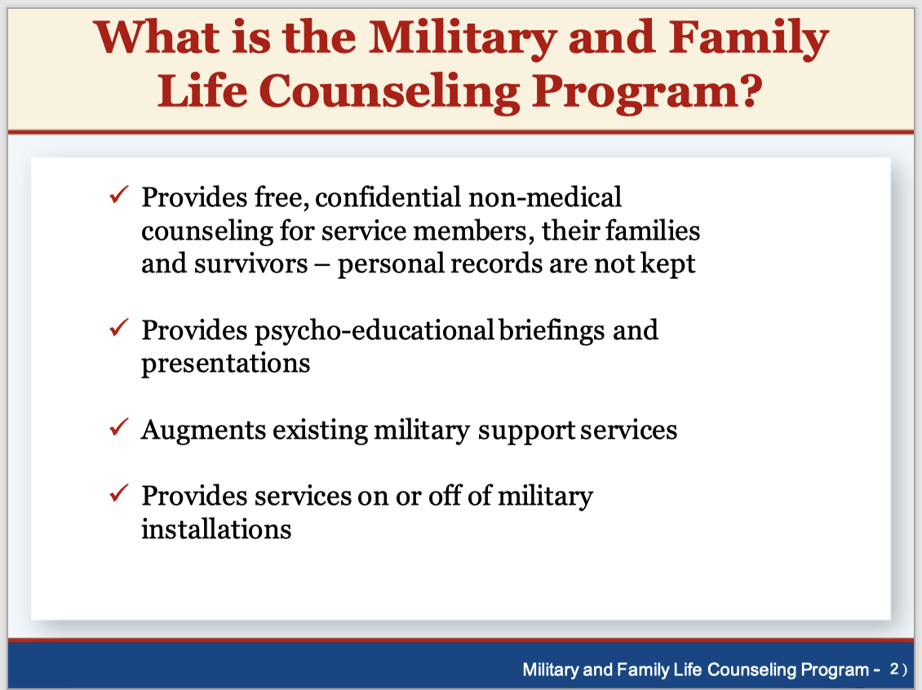

Slide 39
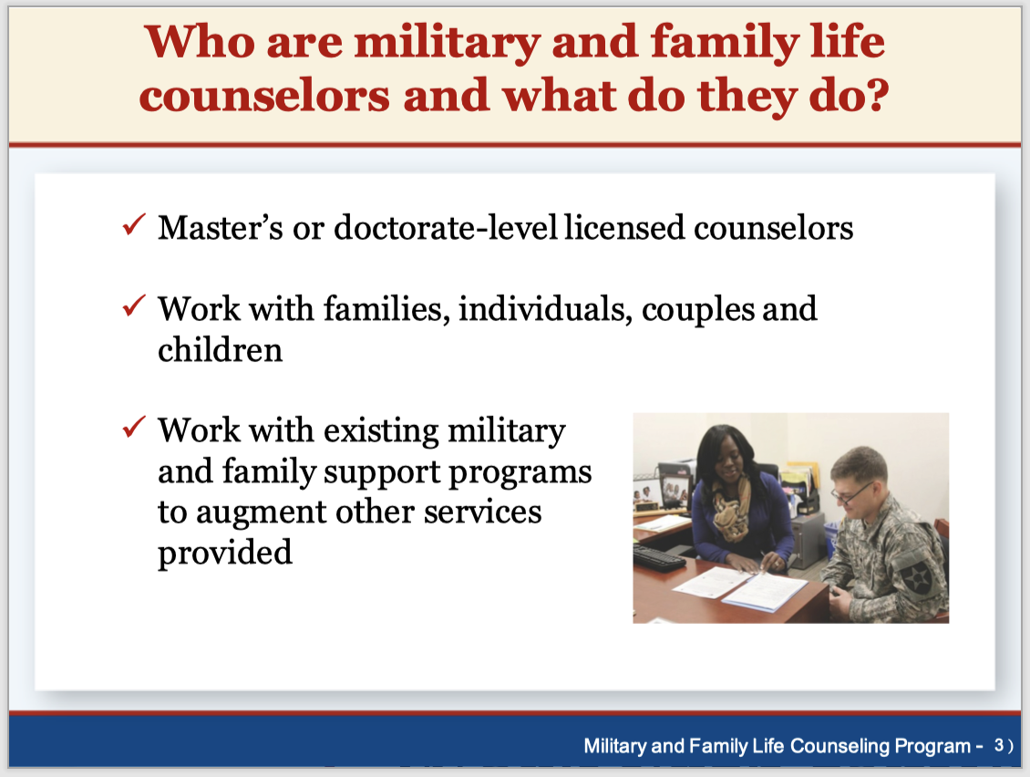

Slide 40
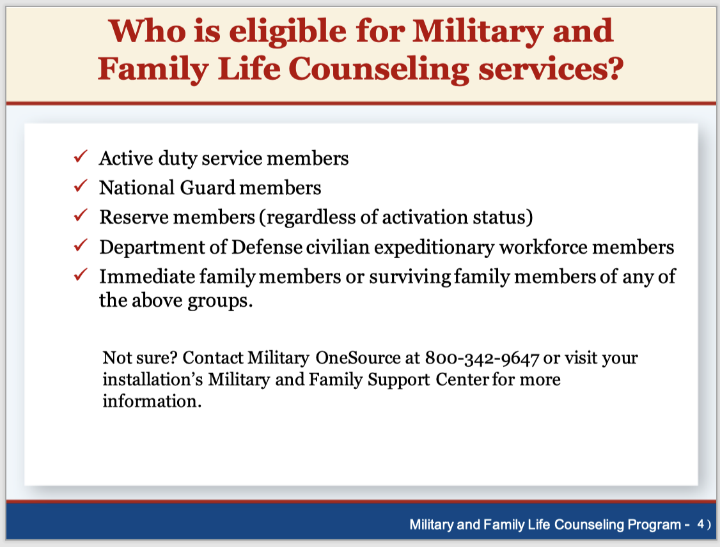

Slide 41
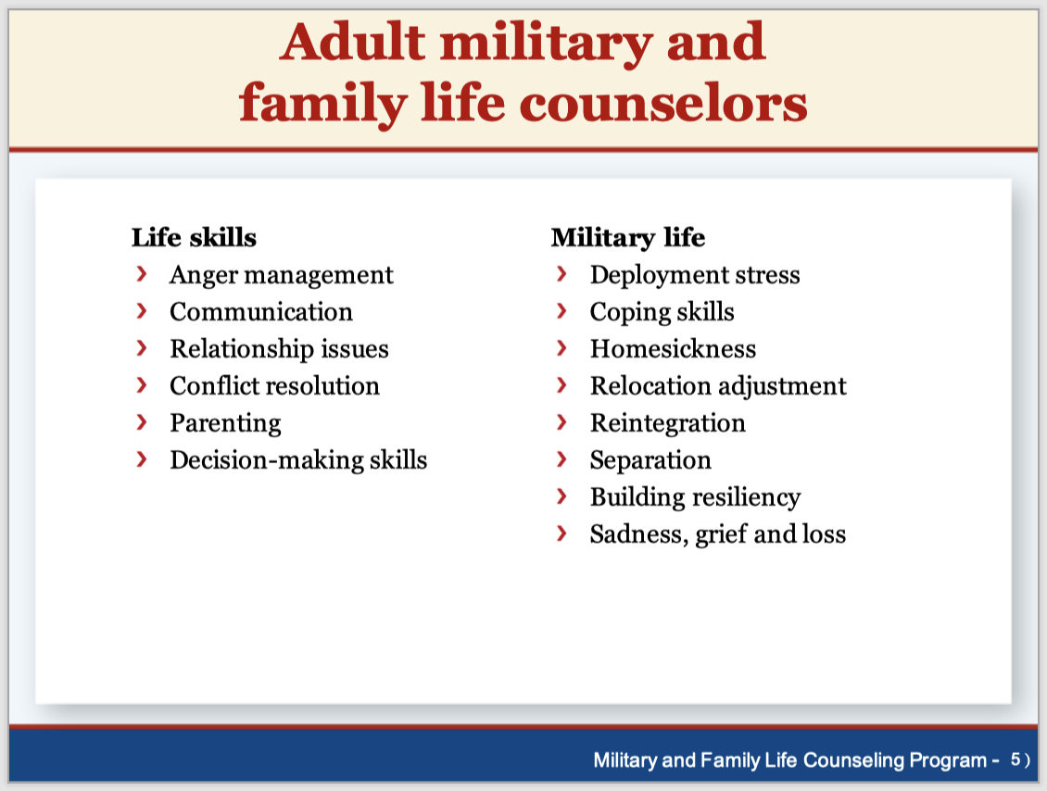

Slide 42
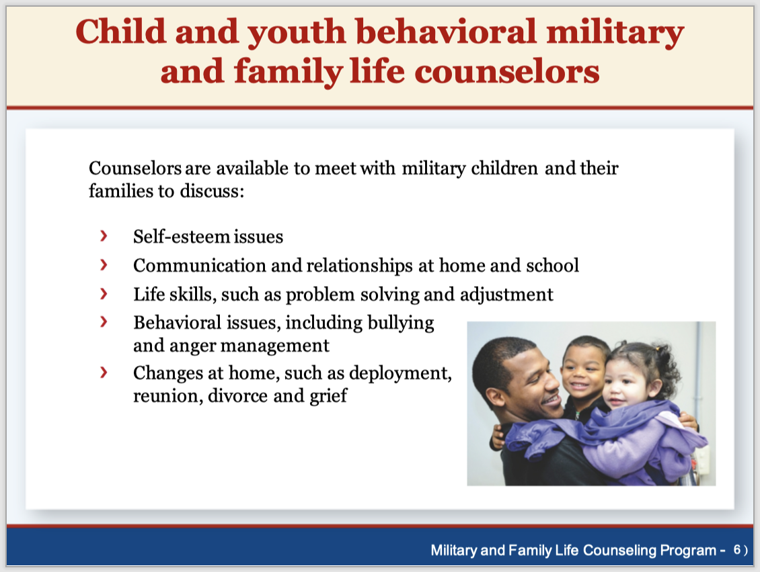

Slide 43
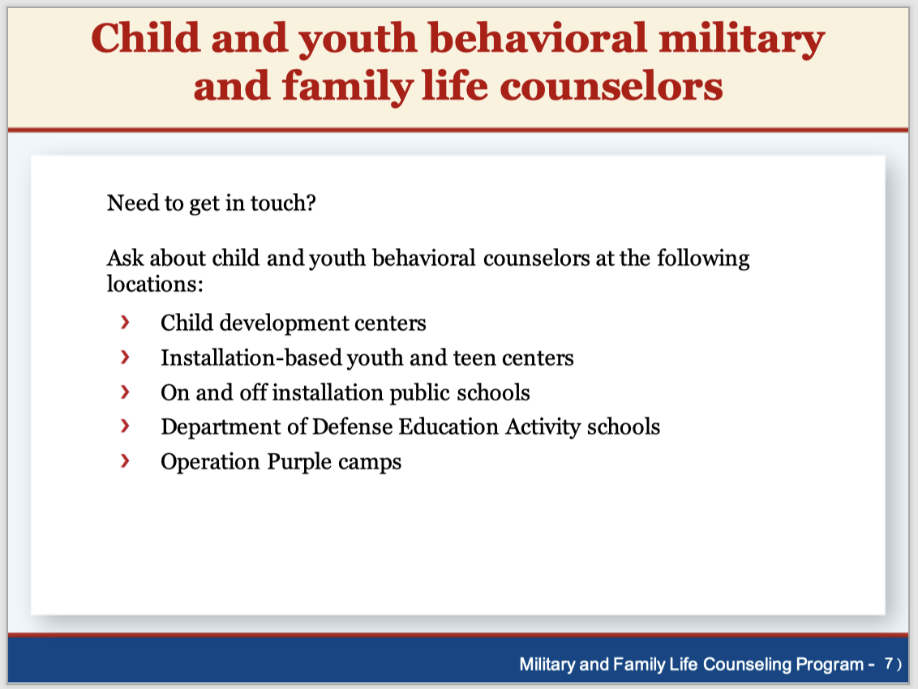

Slide 44
Adopt-A-School (AAS)
Program Overview
Ms. Tina Smith
Child and Youth Services SLO

Slide 45
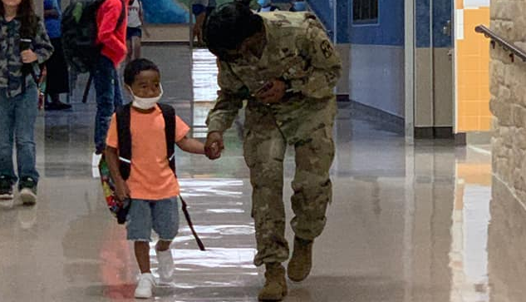


Fort Hood Adopt-A-School Program
Ms. Tina Smith, School Liaison Officer
Adopt-A-School Program Lead
Notes:
“Class, please come to order. Close your mouths and open your ears because I’m going to read you a story. It’s called The Berenstain Bears Go Back to School.
Good Morning/Afternoon everyone and welcome to the Adopt-A-School Meet-And-Greet 2021-2022 for _____________________ Independent School District. My name is Tina Smith, and I am a School Liaison Officer, or SLO, with Child and Youth Services on Fort Hood. With me is Christine Luciano, Environmental Outreach Coordinator with the Directorate of Public Works, or DPW, on Fort Hood. We want to thank Dr./Mr. ______________________ for allowing us to come and _ISD for hosting this Meet-And-Greet.
Today, we are excited to have Fort Hood’s Garrison Commander, COL Foster, in attendance, and would like to invite him to say a few words.

Slide 46
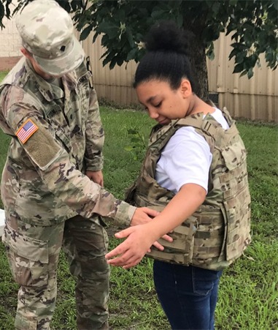
Fort Hood Adopt-A-School Program Mission
***It is the III Corps Commanding General’s intent that the Adopt-A-School (AAS) Program contribute military resources and services to schools in order to nurture the intellectual, emotional, social, and physical growth of children in the greater Fort Hood area.****
1. This is grounded on the conviction that a general diffusion of knowledge is essential for the welfare of the nation that we, as soldiers in the United States Army, defend and for the preservation of the liberties and rights of citizenship.
2. It is further grounded on the conviction that a successful public education system is directly related to a dedicated and supportive family and community, and that parental and community involvement in the school is essential for the maximum educational development of a child.
Notes:
Now, let’s get in to the meat of why you are here…Adopt-A-School.
(Are there any repeat AAS POCs in the room? How about school personnel who are new to the program?-giveaways)
So, in 2004, General McFarland, III Corps Commanding General, began the Adopt-A-School Program on Fort Hood because he believed that “parental and community involvement…”

Slide 47
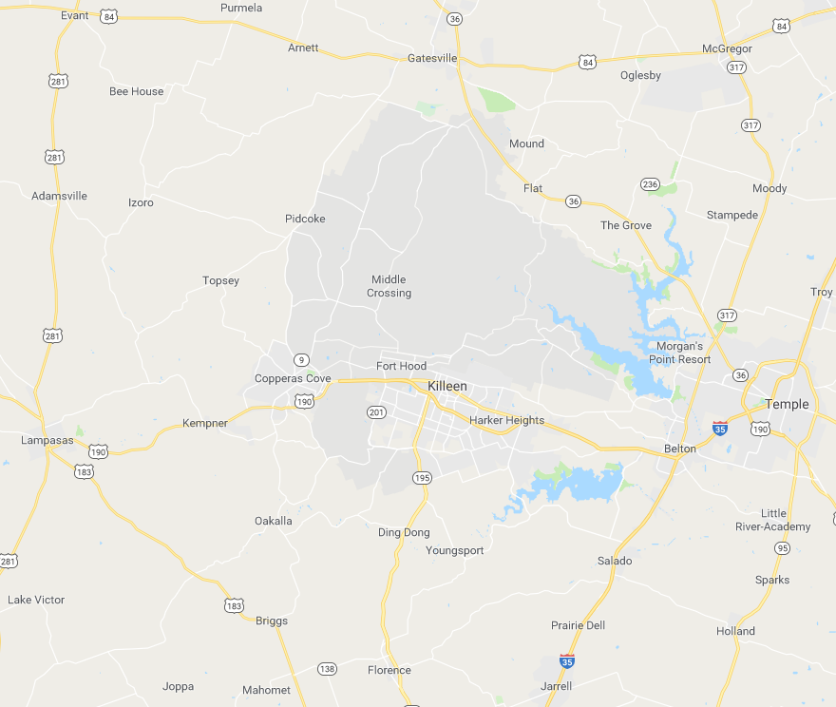
Fort Hood Adopt-A-School Program Support
Fort Hood Supports the Following Number of Schools as of 2021:
Belton ISD- 19 Schools to Include DAEP
1CD, 13ESC, 3CR, NCOA
Copperas Cove ISD- 11 Schools
1CD, 11SIG, 36ENG, 3ASOG
Florence ISD- 3 Schools
OTC
Gatesville ISD- 5 Schools
1CD, DIV WEST
Jarrell ISD- 4 Schools
1-CD
Killeen ISD- 52 Schools to Include BCJJAEP
1CD, 3CR, 11SIG, 36 ENG, 48CHEM, 69ADA, 504MI, 11MP(CID), 3ASOG, 901 CCBN, DENTAC, MEDCEN, PHA, III Corps, SAMC, 3SFAB
Lampasas ISD- 5 Schools
89MP, 15MI
Salado ISD- 3 Schools
3CR
Temple ISD- 15 Schools
1CD, 13ESC, 3CR, 36ENG, 3ASOG
Total: 117 Schools
Notes:
Fort Hood supports a total of 117 schools spread across 9 school districts. 86 units participate in the program, so if you do the math, you find that some units have 2 or even 3 schools that they have adopted. This slide depicts the breakdown.

Slide 48
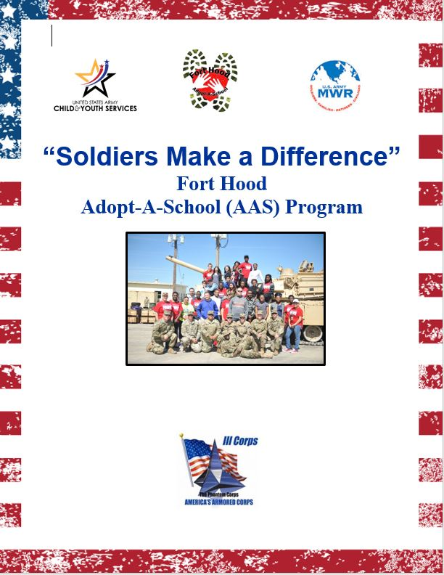
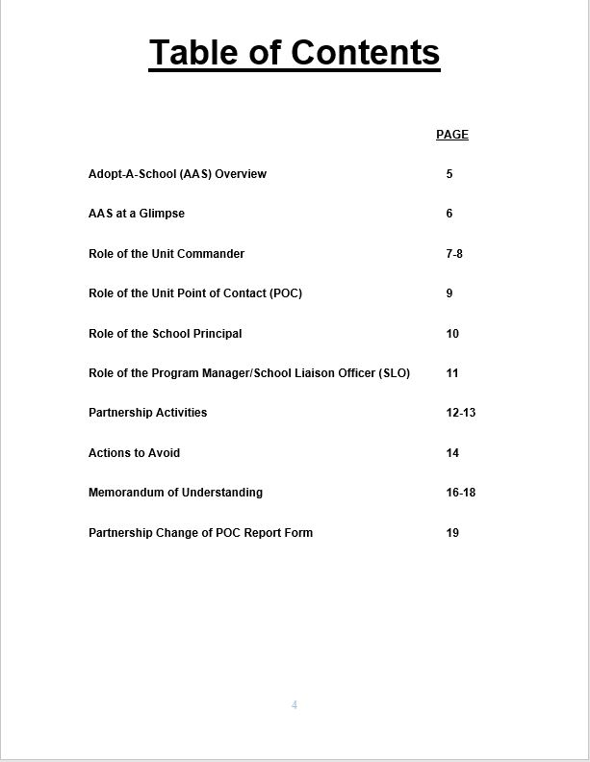
Fort Hood Adopt-A-School Program Guidelines
Notes:
There is an Adopt-A-School bible. If you’re a Soldier, this is Enclosure 4 to the OPORD. At the conclusion of the Meet-And-Greet, please let me know if you would like me to send you the OPORD and Enclosures. School personnel, I can send this to your Adopt-A-School administrator. However, I’m going to provide an overview of the information in it now.

Slide 49
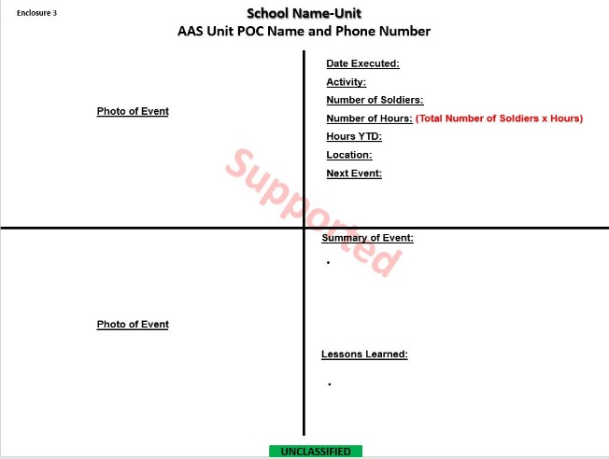
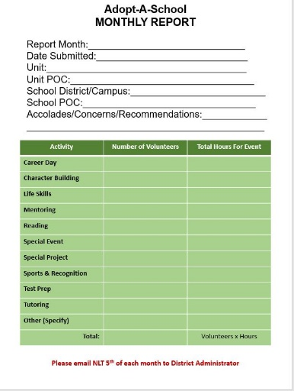
Fort Hood Adopt-A-School Program Accountability
Units
Storyboards for Supported Events, Unsupported Events, and Communication
Schools
Monthly Campus Reports
Notes:
Unit POCs (primary and alternate) take an active interest…

Slide 50
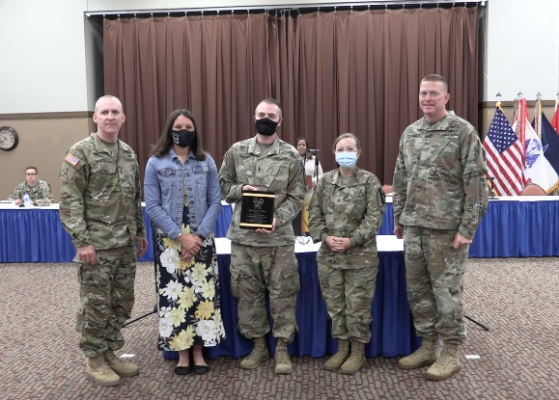
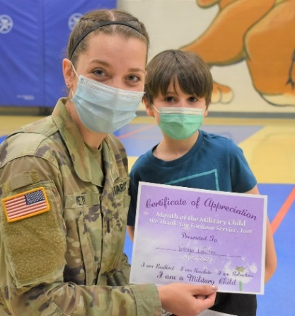
Fort Hood Adopt-A-School Program Recognition
Monthly Storyboard Feature on Garrison Facebook Page
Adopt-A-School Awards
Outstanding Individual: One AAS Service Member or Civilian Volunteer (School or Unit)
Outstanding School Point of Contact (POC) : One School Employee
Outstanding Unit Point of Contact (POC): One AAS Service Member or Civilian Volunteer Per District
Outstanding Unit Commander: One Unit Commander (Any Level)
Partnership of the Year Award: One AAS Unit and School Partner
Top Hours Award: 1st-3rd Place
Notes:
All participating individuals serve a role in the Adopt-A-School Program.
Take a minute or two and read the role of the Unit Commander. Let me have a volunteer or two to share something that they feel is important or something that surprises them under the commander’s role. (giveaways)

Slide 51
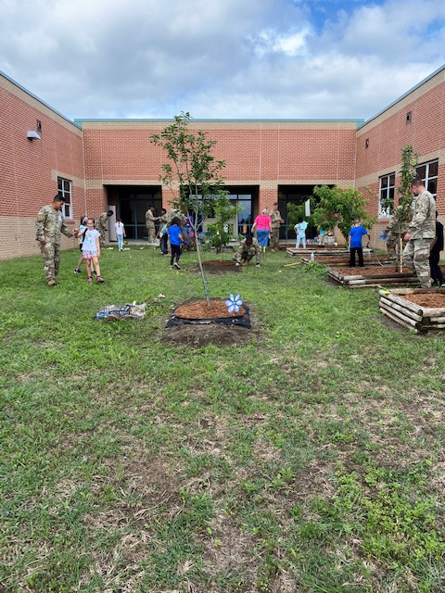
Questions?
Contact the CYS School Liaison Office at (254) 553-3341
or usarmy.hood.imcom-fmwrc.mbx.slo@mail.mil

Slide 52
Adopt-A-School (AAS) Program Presentation by Units

Slide 53
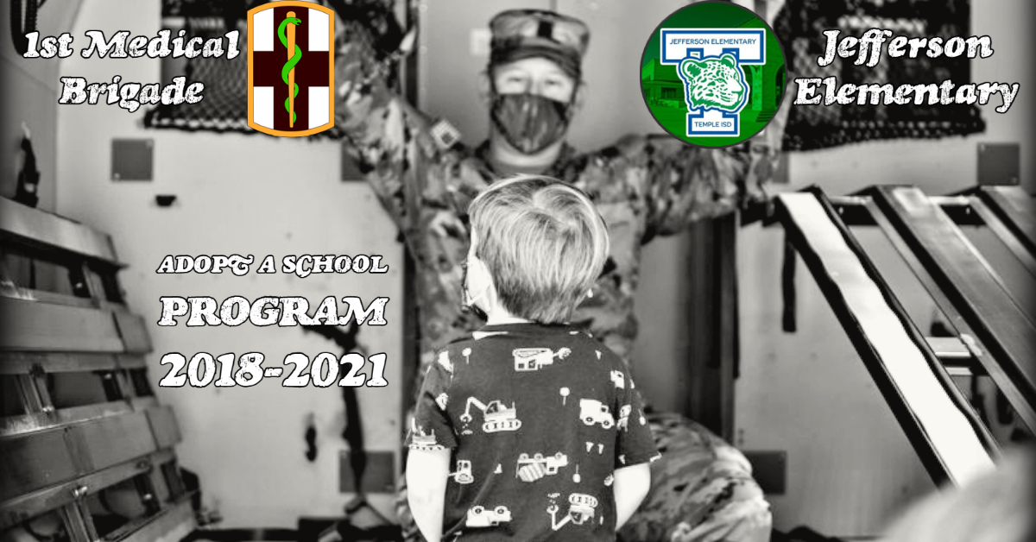
528th Hospital Center

Slide 54
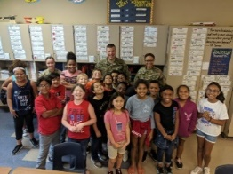
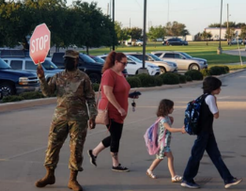


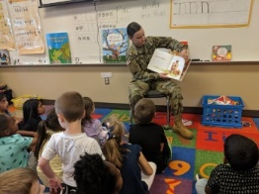
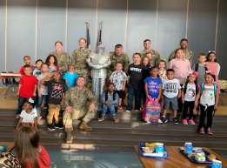
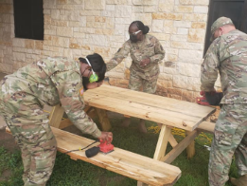
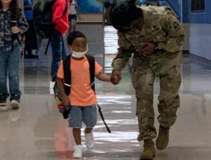
Ingredients For A Successful Partnership
Expectation Management and Resources
1 MED / Jefferson
Snapshot
Joint Planning and Team Building
Communication, Communication, Communication
Mutual Support
4+ year relationship
Over 370 engagement hours
50+ Events
Nine (9) different AAS Reps
Flexibility and Adaptability
Feedback and Reporting

Slide 55


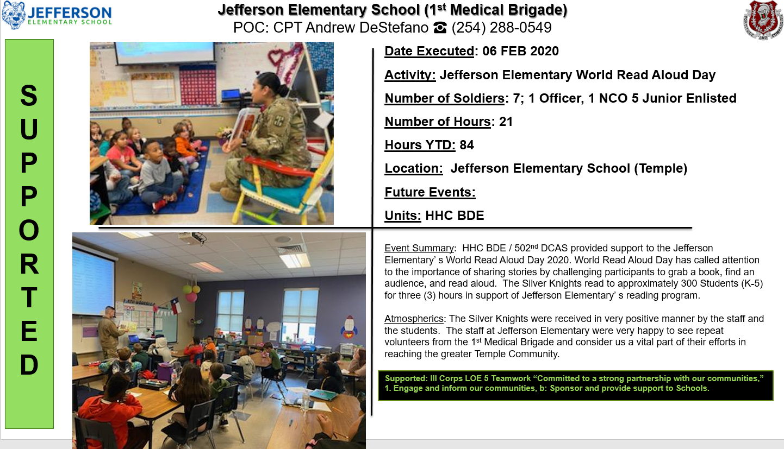
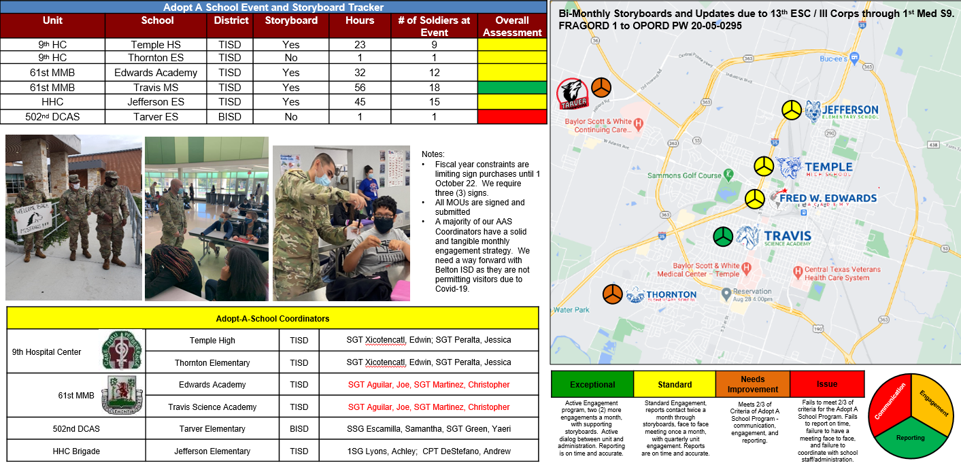
Topics of Discussion
Awareness and Reporting
Sustain +
Community Support and Engagement
Staff Involvement and Support
Proactive Approach
Improve -
Communication and Forecasting
Leader Involvement
Recognition

Slide 56


Questions?

Slide 57
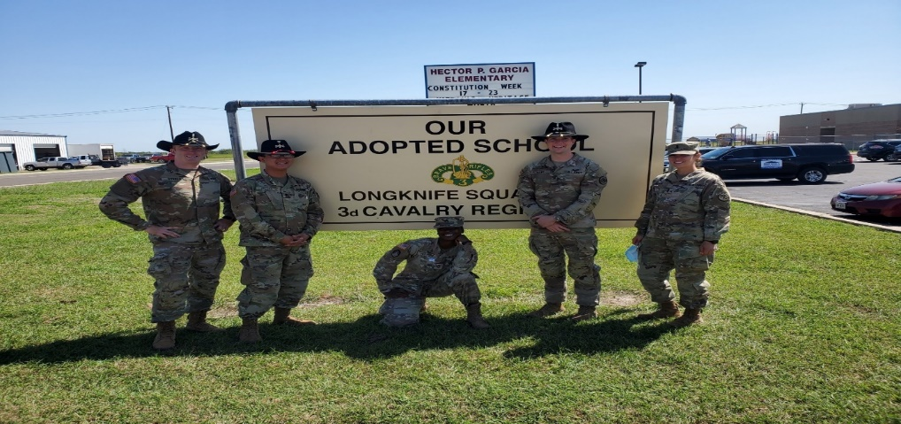
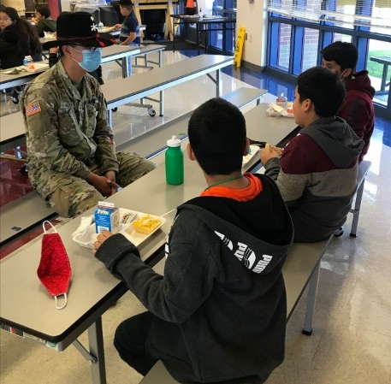
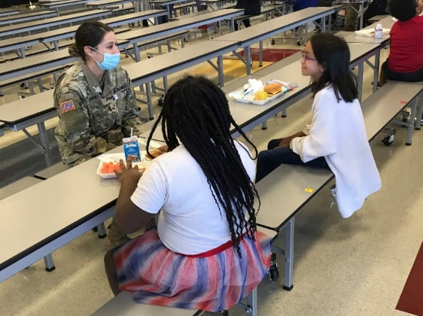
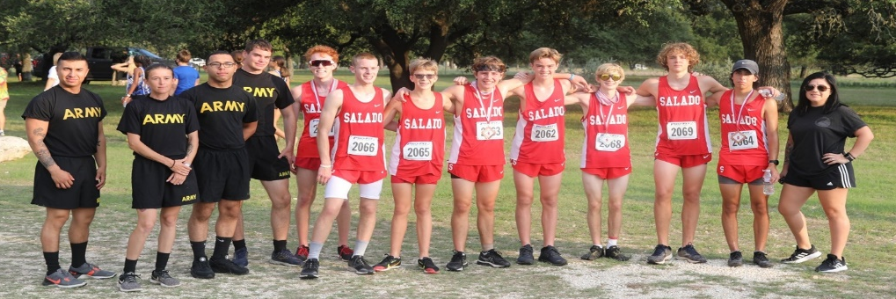
4/3d CR Adopt-A-School Successes
Garcia Elementary and Salado High School
Ownership
  Show ownership of the relationship between the school and your Squadron. Students and staff look to be part of your team. A little effort is all that’s required.
Scheduling Events
  Before leaving the last 15 minutes would always be a sit down to confirm the next event and plan the following month. The goal was two events a month.
Enthusiasm
  Young students require a mass of energy to engage and keep their interest. When performing read alouds to Garcia Elementary, emphasizing words and even acting out some portions are required to maintain that connection.
Moral of the Story
  At the end of every book read, engage the students further by asking them questions on the story. Ask them what they understand about it. Provide that right and wrong description about the story and be the positive role model needed.

Slide 58
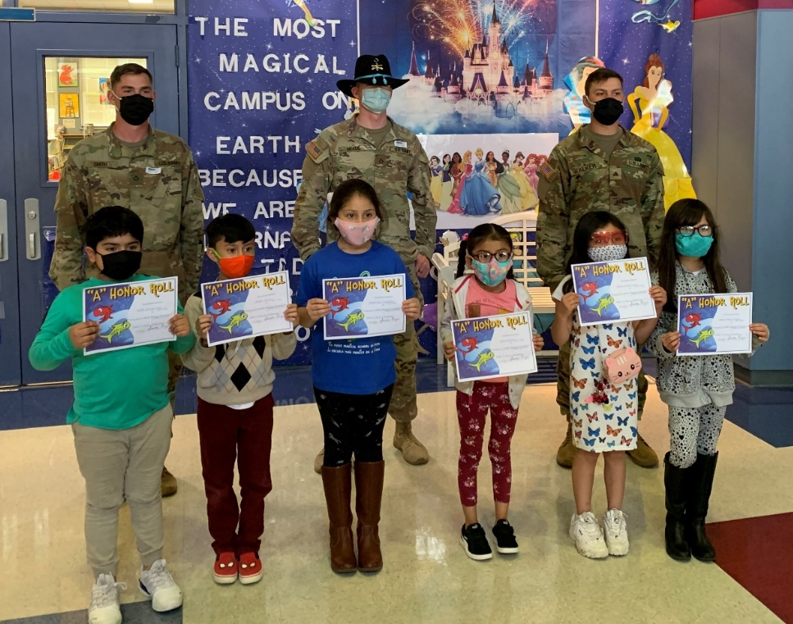
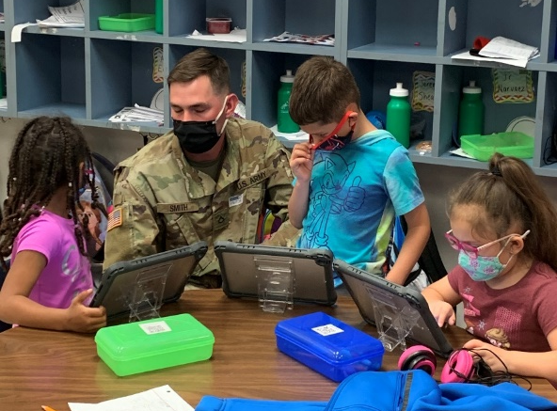
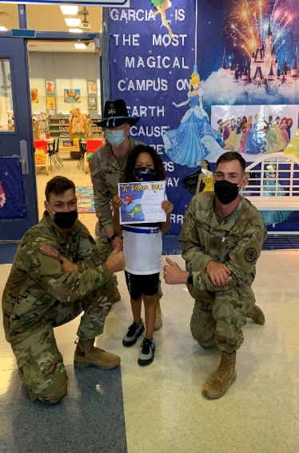
4/3d CR Adopt-A-School Successes
Garcia Elementary and Salado High School
Patience
  Some Schools are inherently busier than others and have a different priority. Have patience and work with them so have a quality event instead of rushing it.
Persistence
  Communication is key, you don’t want to harass the school and make it sound like you’re trying to force them. However always give them a simple email or leave a voicemail letting them know you’re still ready to work with them.
Academic Events
  Academic encouragement is key to growth. Acknowledge that importance and instill it into the students. Whether or not they pursue a career in the military, the best way to achieve their dreams is to learn and excel in academics as much as possible.
Be a Super Hero
  In the eyes of these young students, you are a super hero. Act like it and show other Troopers what its like to be a positive influence in someone else's life.

Slide 59

Thank you for attending the 2021 Schools Council Meeting

